Slide 1

CRYPTOTRANSFER PLATFORM
Under the supervision of :-
Mrs. Arushi Gupta
Submitted by :-
Mohd. Wasim
Abhay Pratap Singh
Charchit Kumar Chauhan

Slide 2
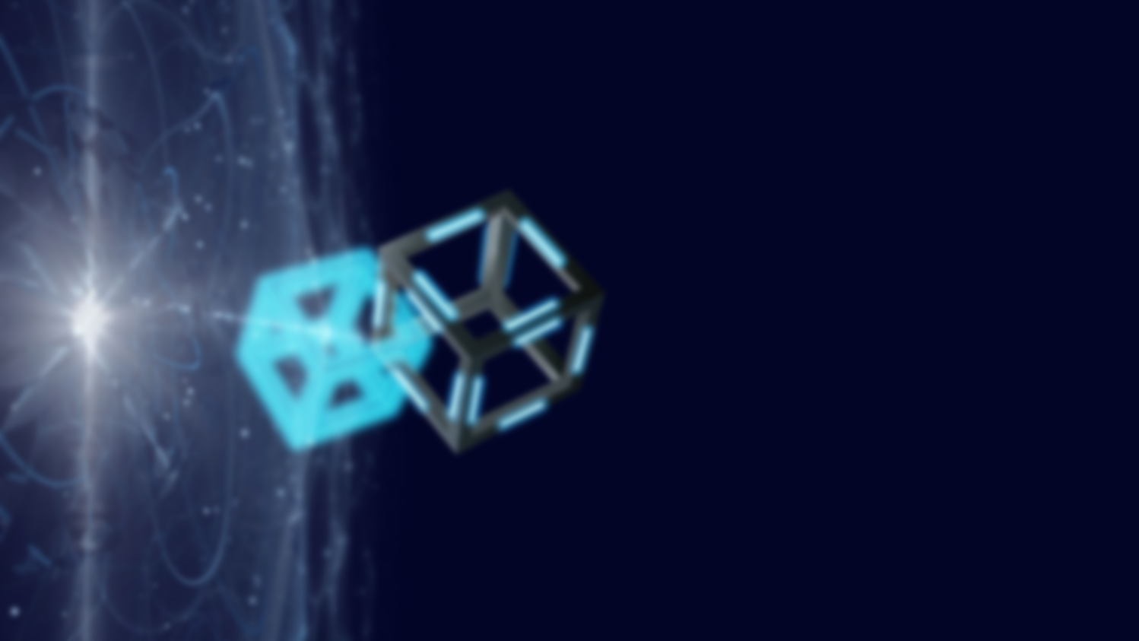
INTRODUCTION
1.Transactions in conventional financial systems must continually be verified by a third party.
2. if a person wants to use a credit or debit card to purchase anything from a market, the transaction must be approved by a bank or other financial organization.
3.She/he must first take money from the bank in order to utilize cash for the purchase, so a third party is always involved in some capacity in order to validate or verify a transaction.
4.In this way, a third party centralizes the transaction process. Additionally, this blockchain also stores every transaction.

Slide 3
PROBLEM STATEMENT
Our model is a transaction platform which provides Peer-to-peer
autonomous digital currency system.
We are trying to make it secure and stable by integrating the concepts
of blockchain.
Which provides validation ,verification and records of data.
Two main contribution of our project.
A working digital currency system and .
An autonoumous decentralized technology called the blockchain.

Slide 4
OBJECTIVE
01
INDEPENDENT PLATFORM
It provides a platform which provide scalable and stable transaction .
DISTRIBUTED LEDGER
02
It provides the transparency to the system .
MULTI TASKING
03
Everyone can perform/participate in the transaction
TRUSTWORTHY
04
Makes the ecosystem reliable and secure.

Slide 5
ABSTRACT
A
Problem statement
We seek in the problem that there is slow governing system and public sectors .
How to resolve it
B
Provide the faster, secure and cost-effective governmental system.
C
Summary
We made a platform which keep a side the middlemen and provide user-friendly system .
Conclusion
D
We used the blockchain technology to overcome the general problems like security and transparency .

Slide 6
WHY BLOCKCHAIN
Programmable
A blockchain is programmable.
Secure
Distributed
All records are individually encrypted.
All network participants has the copy of the ledger for complete transparency.
Anonymous
Immutable
The identity of participants is either anonymous or pseudonymous.
Any validation records are irreversible and cannot be changed.
Time-stamped
A transaction timestamped is recorded on a block.

Slide 7
TRANSACTION PROCESS
BROADCAST
VALIDATION
SERVER REQUEST
A transaction is requested and authenticated.
NODE VALIDATE THE TRANSACTION
TRANSCATION COMPLETED
A block is added to existing blockchain
A block contain transaction history

Slide 8
TECHNOLODY USED
REACT.js
We used react.js for our frontend work the website which is user-friendly .
01
BLOCKCHAIN
We used several technology, framework and APIs
It is an especially promising and revolutionary technology because it helps to reduce security risk , stamp out fraud and bring transparency.
WEB-3
02
It uses the cryptocurrency for spending and sending money online instead .of relying on outdate infrastructure of bank and other platform .
Example :- We have used various technology in our project which is not only new but also booming now a days.
Blockchain and Web3 is one of them .
03
GANACHE
It is private Ethereum blockchain environment that allow you to emulate the Ethereum blockchain so that you can interact with the smart contacts.
METAMASK
04
It is software cryptocurrency wallet used to interact Ethereum Blockchain.
05
NODE.js
.It used to start the server and combine it with frontend part .
06

Slide 9
REFERENCES
1.https://www.investopedia.com/terms/b/blockchain.asp
2. https://www.ibm.com/in-en/topics/what-is-blockchain
3. https://www.euromoney.com/learning/blockchain-explained/what-is-blockchain
4. https://en.wikipedia.org/wiki/Blockchain
5. https://builtin.com/blockchain

Slide 10
THANK YOU

